Slide 1

Java Inner Class

Slide 2
Contents
What is Nested or Inner Class
Advantages of Inner Class
Non static Inner class as data member
static Nested class
Non static Inner class inside method
Anonymous Inner Class
Non static Inner class as parameter to method or constructor
Characteristics of Inner Class

Slide 3
Inner or Nested Class
Another relationship which can exist between classes is Inner Class relationship.
In Java Nested or inner classes, are allowed. That means a class can be
data member of another class
defined inside a method
Class as data member can be
Non static Nested class
Static Nested class
Non static nested class, can be
Data member of another class
Inside a Method as named or Anonymous class
As a parameter to a constructor or Method
As a return value
Any of private, public, protected, (or even static or final) can be used with (data member) Inner class.

Slide 4
2. Advantages of inner classes:
Below are advantages of Inner Classes
Compact code
All related code at one place, easy to understand
Since outer class can be only public or default, where as inner class can be
static or
private or
protected
Builder Design Pattern uses Inner class
Just like Inner class there can be an Inner interface, For eg. in Map.Entry , Entry is inner interface (in Collections)

Slide 5
3. Non static Inner class as data member
class B {
//…
class A{
}
//…
}
Note: After compilation, B$A.class is name of class file., which gets generated
Only default or public access specifier can be used with outer class

Slide 6
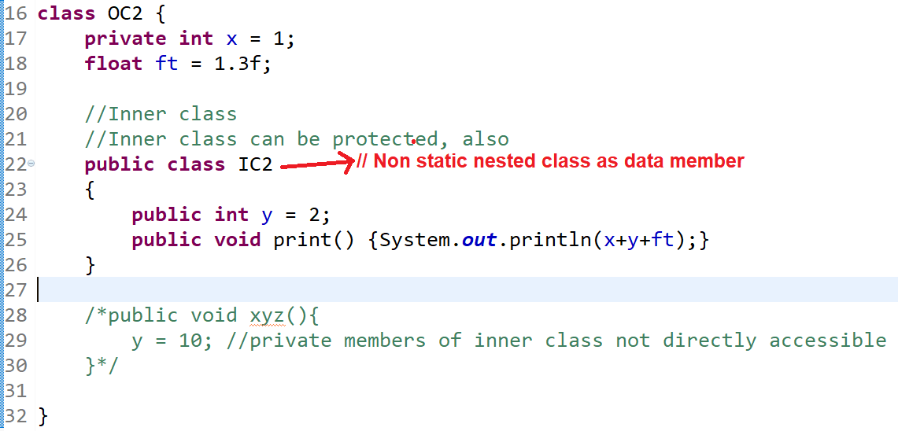
3. Non static Inner class as data member

Slide 7
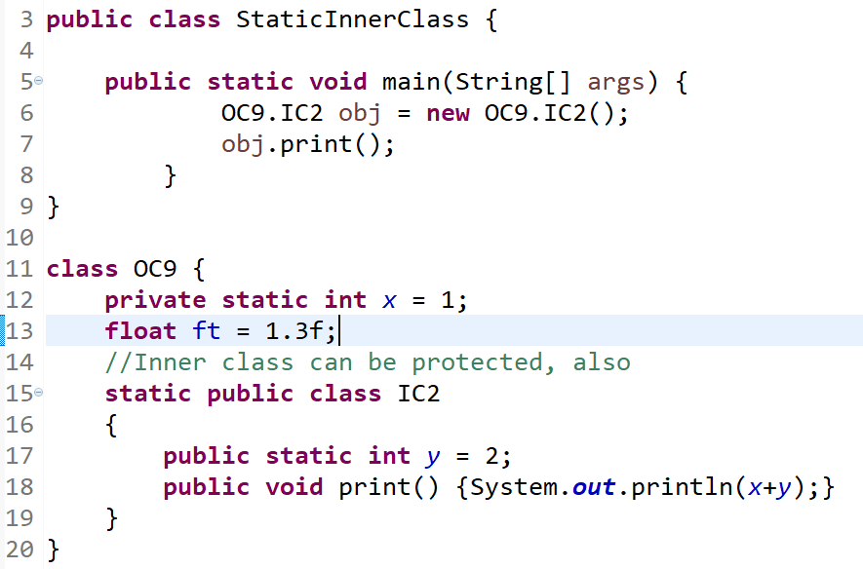
4. Static Nested class
Static Inner class can be data member of another class, and cannot be a parameter of a method, or constructor.
Below example shows that a static class as data member of another class.

Slide 8
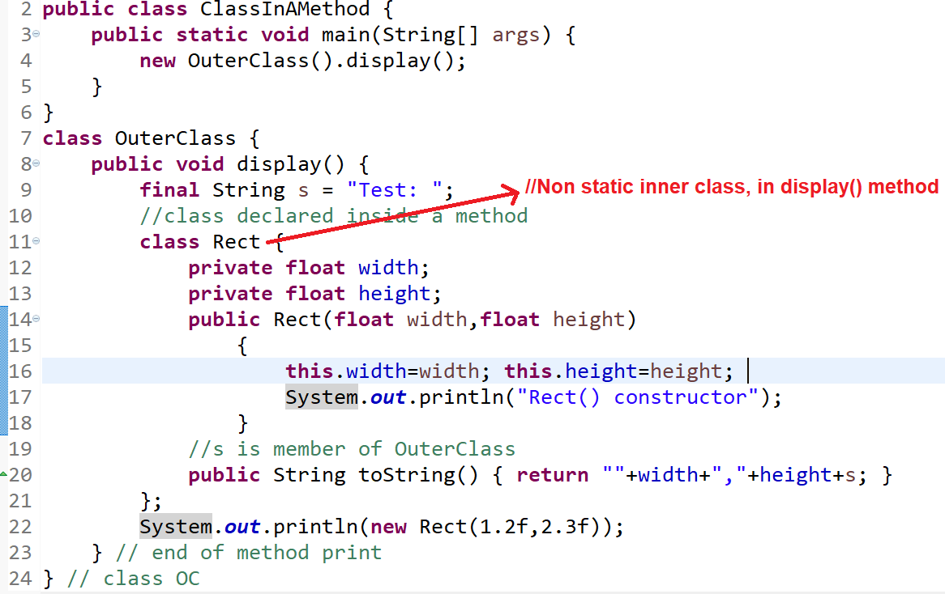
5. Non static Inner classes defined inside method

Slide 9
6. Anonymous Inner classes
Anonymous Inner class is a inner class without a name.
Some usages of Inner classes concept are to create Thread functionality, Event Handling(in AWT) and Comparator in Collections, etc…
//highlighted part in red is Anonymous object of Anonymous class, which is passed as parameter

Slide 10
6. Anonymous Inner classes
TreeSet<String> tss = new TreeSet<String>(new Comparator(){
int compare(String str1, String str2){
return str2.compareTo(str1);
}
);

Slide 11
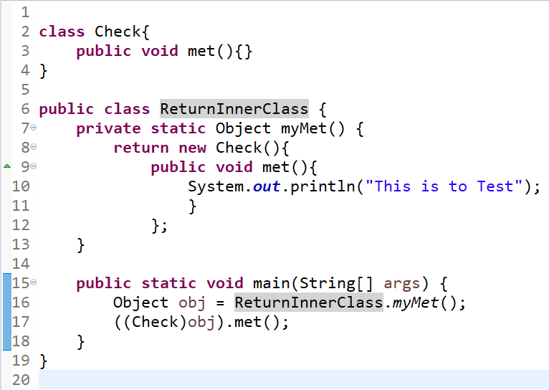
Anonymous Inner classes
Inner class used in return type
Anonymous Inner class

Slide 12
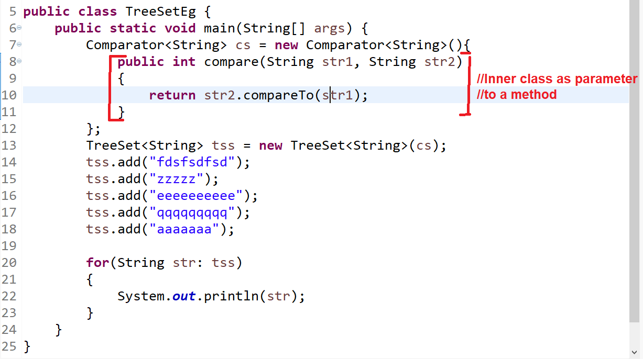
7. Non static Inner classes as a parameter of a method or a constructor

Slide 13
8. Characteristics of Inner Class
Incase of non static inner class, inner class instance can be created only after instance of outer class is created.
Incase of non static Inner class, a reference of outer class is implicitly passed to Inner class, there by delaying Garbage collection of outer class object.
Static inner class can be instantiated even before instantiating outer class.
Memory usage for static inner class is less, as no extra reference is passed, and no garbage collection issues.

Slide 14
Thank You!

